Slide 1
Smarty Templates & Processing capabilities
Notes:
Smarty is a template engine for PHP, facilitating the separation of presentation (HTML/CSS) from application logic. This implies that PHP code is application logic and is separated from the presentation.

Slide 2
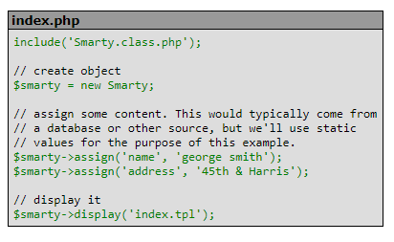
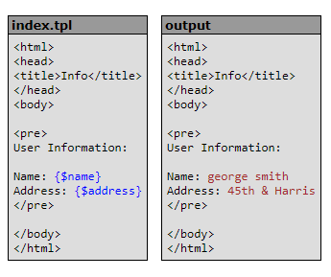
Basic Templating in Smarty
Input and Output in Smarty:
Assign Content to Smarty as a index.tpl file
Presents the output of the template file with the attributes that were given by the user

Slide 3
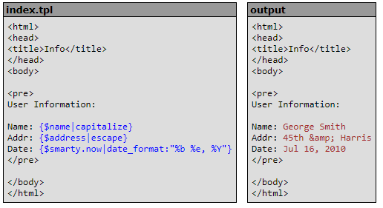
Analysis of the Smarty Output
Separates the presentation (HTML/CSS) from your application (PHP) code
The purpose of Smarty is to help keep the template design (front-end) separated from the application programming role (back-end)
Ultimately, this helps us remodel the template (of the content) without altering the application code
i.e. If the template defines that the name of the user must be capitalized, then Smarty will capitalize the name that was defined in the PHP application

Slide 4
Analysis of the Smarty Output
In the output, we can justify that certain modifiers can be used in a template in order to modify the placeholders that stores the data in a variable (such as name, address, date, and so on)
This means that the output can be modified in many ways under the discretion of the user in the template
On that note, the application programmer can replace an attribute (name, address, data, etc.) to manipulate the data that is displayed in the templates

Slide 5
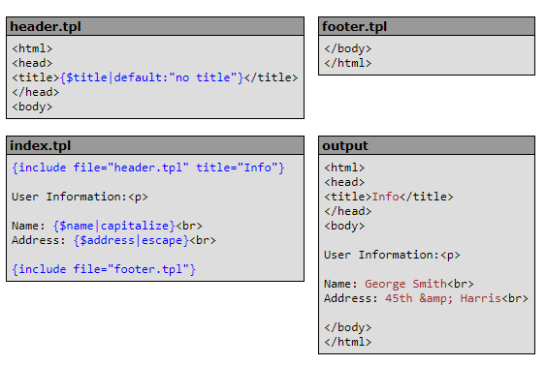
Template Functions
Carry out tasks in the template that is handled by the application programmer
{include} – Inclusion of other templates created through a header/footer
Scope = Locally stored data
A template variable will not be assigned directly, but rather be passed as an attribute
The variable is available within the scope of the header template, and can be dynamically allocate the data any time when the tpl is included

Slide 6
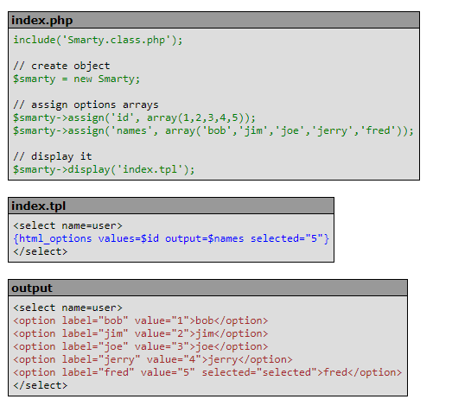
Template Functions
{html_options} – Helps generate a set of select options
A custom function that creates the html <select><option> group with the assigned data
Takes care of which attributes are defined as default (as in remaining static throughout the program)

Slide 7
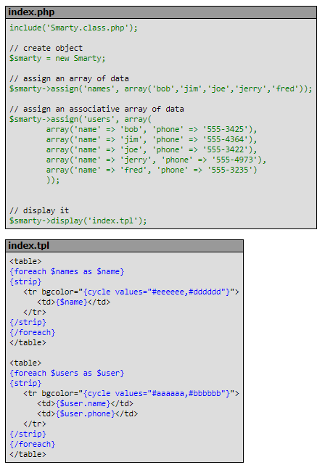
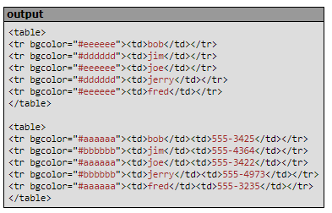
Template Functions
{cycle} – Cycle through a set of values
Example: Alternate between two or more names in an array
Cycling through an array of digits for random generator

Slide 8
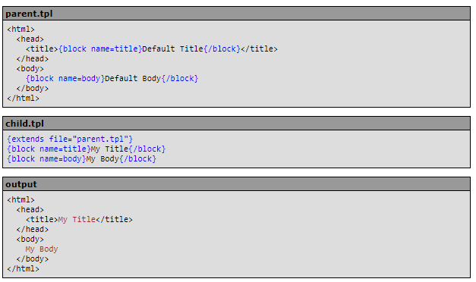
Template inheritance
Starting with a base, skeleton code (parent template), template inheritance is the method of supporting child templates that can override the placeholders that are provided in a parent template
These changes ONLY reflect when {blocks}, which are placeholders in Smarty, are used to create a base template:
Notes:
Templates can now inherit from each other. You mark blocks of a template with {block name=foo}{/block} tags, a template can inherit with the {extend file="my.tpl"} tag, and then you can replace, change or append the blocked contents from the inheriting template(s).

Slide 9
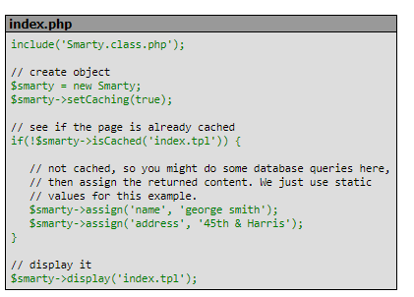
Built-in caching capabilities
Purpose: To help speed page rendering
Process:
Copy of the template output is stored in a text file
The text file is displayed upon subsequent calls to the request instead of dynamically rendering the page each time
Example: If the page is already cached, then assign the returned content where static values are used to define the name and address attributes

Slide 10
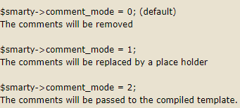
Conclusion
Overall, I believe that placeholders are changed under the discretion of the template designer (front-end) and application programmer (back-end)
I saw a forum post of Smarty, where they mentioned placeholders that appear in comments. Like that idea, it is sufficient to grasp that same logic in terms of php and tpl:
Conditions for the logic:

